Slide 1

The Science of Sports Nutrition
CARBOHDYRATE 101

Slide 2


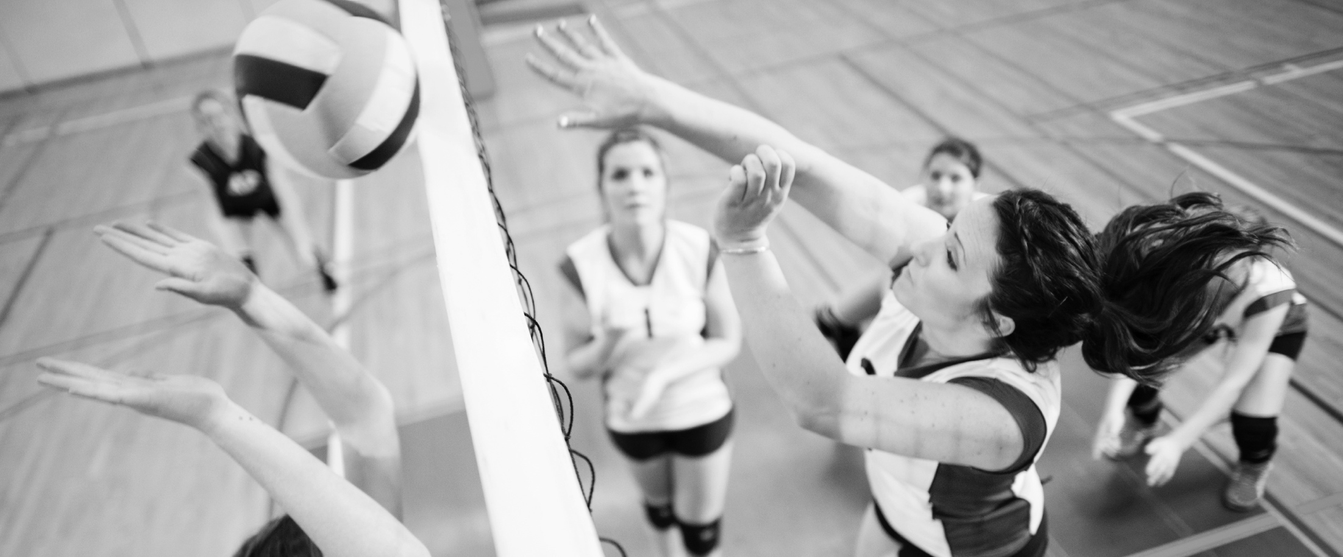
Carbohydrate early works
Blood Glucose
(mmol/L)
CHO Oxidation
(g/min)
CARBOHYDRATE
CARBOHYDRATE
PLACEBO
PLACEBO
TIME/MIN
TIME/MIN
Coyle et al. 1986, J Appl Physiol 61:165-172.
Notes:
Controlled laboratory studies related to carbohydrate intake during exercise began to be published in the 1980s. Coyle et al [4] demonstrated that blood glucose concentrations dropped to very low levels towards the end of exercise when subjects exercised at 70% to exhaustion over 3 hours. However, when study participants were fed glucose during exercise, blood glucose concentrations and total carbohydrate oxidation rates were maintained, prolonging time to exhaustion by 1 hour.
Over the years, published research has accumulated to look at types, amounts, performance outcome, and much of that work was done with endurance type exercise

Slide 3
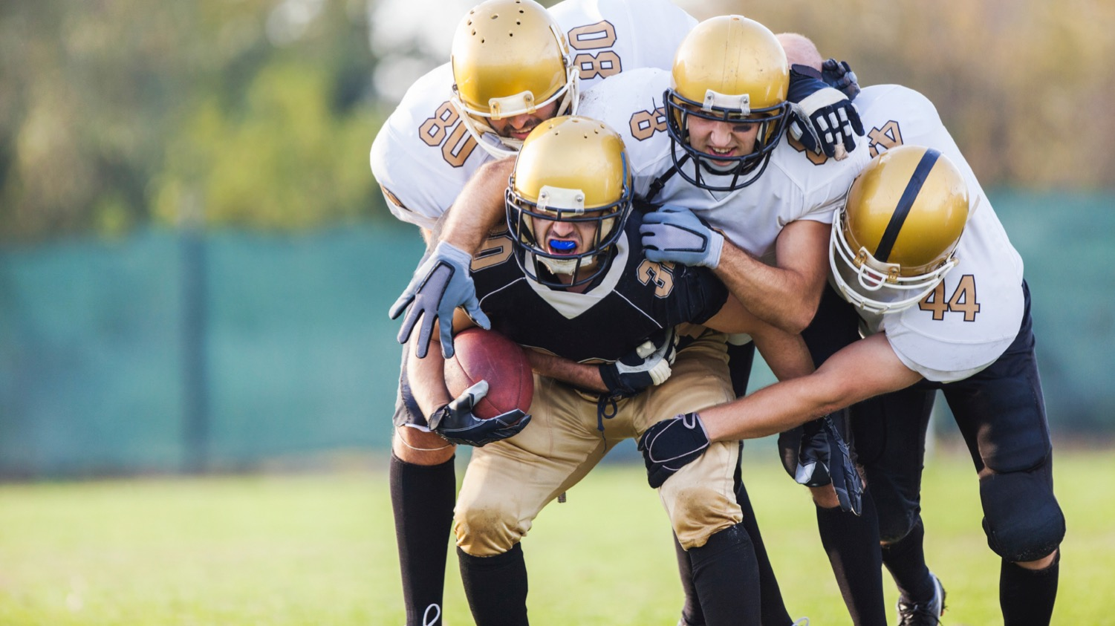
Carbohydrates are the primary fuel for muscle contraction
Notes:
verall, in most activities most of the time, carbohydrate will be the predominant energy source
Additional voice over:
Vitamins and minerals are often associated with “energy”. However, they are not fuel. Some of the micronutrients support the energy production pathway. For example, iron is important to carry oxygen in the blood to the muscle, where it is used in aerobic pathways to convert carbohydrate and fat to energy (ATP). B vitamins help enzymes in the muscle in their role of converting carb and fat to energy.

Slide 4
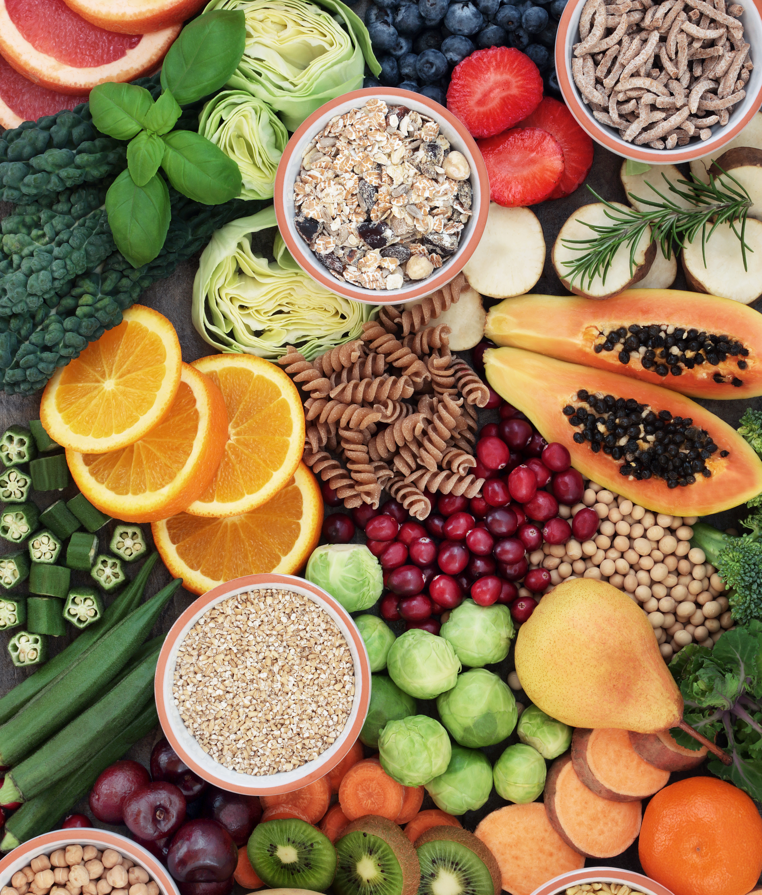
DAILY CARBOHYDRATE SUPPORTS GLYCOGEN STORAGE
Light Activity: 3-5 g/kg
Moderate Activity: 5-7 g/kg
High Activity: 6-10 g/kg
Very High Activity: 8-12 g/kg
Joint Positon Statement: Nutrition and Athletic Performance. Med Sci Sports Exerc. 48:543-68. (2016)
Notes:
In preparation for daily training sessions, an athlete should focus on a carbohydrate rich diet. The exact amounts that the athlete should consume can be tailored based on the individual athletes’ total energy needs and training session needs. The above recommendations are meant to provide high carbohydrate availability (ie, to meet the carbohydrate needs of the muscle and central nervous system) for different exercise loads for scenarios where it is important to exercise with high quality and/or at high intensity.
More specifically, an athlete can further tailor carbohydrate intake in the pre- during and post-training occasions.

Slide 5


CONSUMING CARBOHYDRATES STRATEGICALLY AROUND TRAINING WILL…
Maintain high rates of carbohydrate oxidation
Reduce ratings of perceived exertion
Increase endurance capacity
Delay the onset of fatigue
Prevent hypoglycemia
Cermak & van Loon. 2013, Sports Med, 43:1139-1155.Jeukendrup, A. 2004, Nutrition, 20:669-677.
Notes:
Over the years, a large body of literature has been developed around endurance… In general, when compared with placebo ingestion during exercise longer than 2 hours, carbohydrate feeding will; prevent hypoglycaemia, maintain high rates of carbohydrate oxidation, delay the onset of fatigue, reduce ratings of perceived exertion and increase endurance capacity.

Slide 6
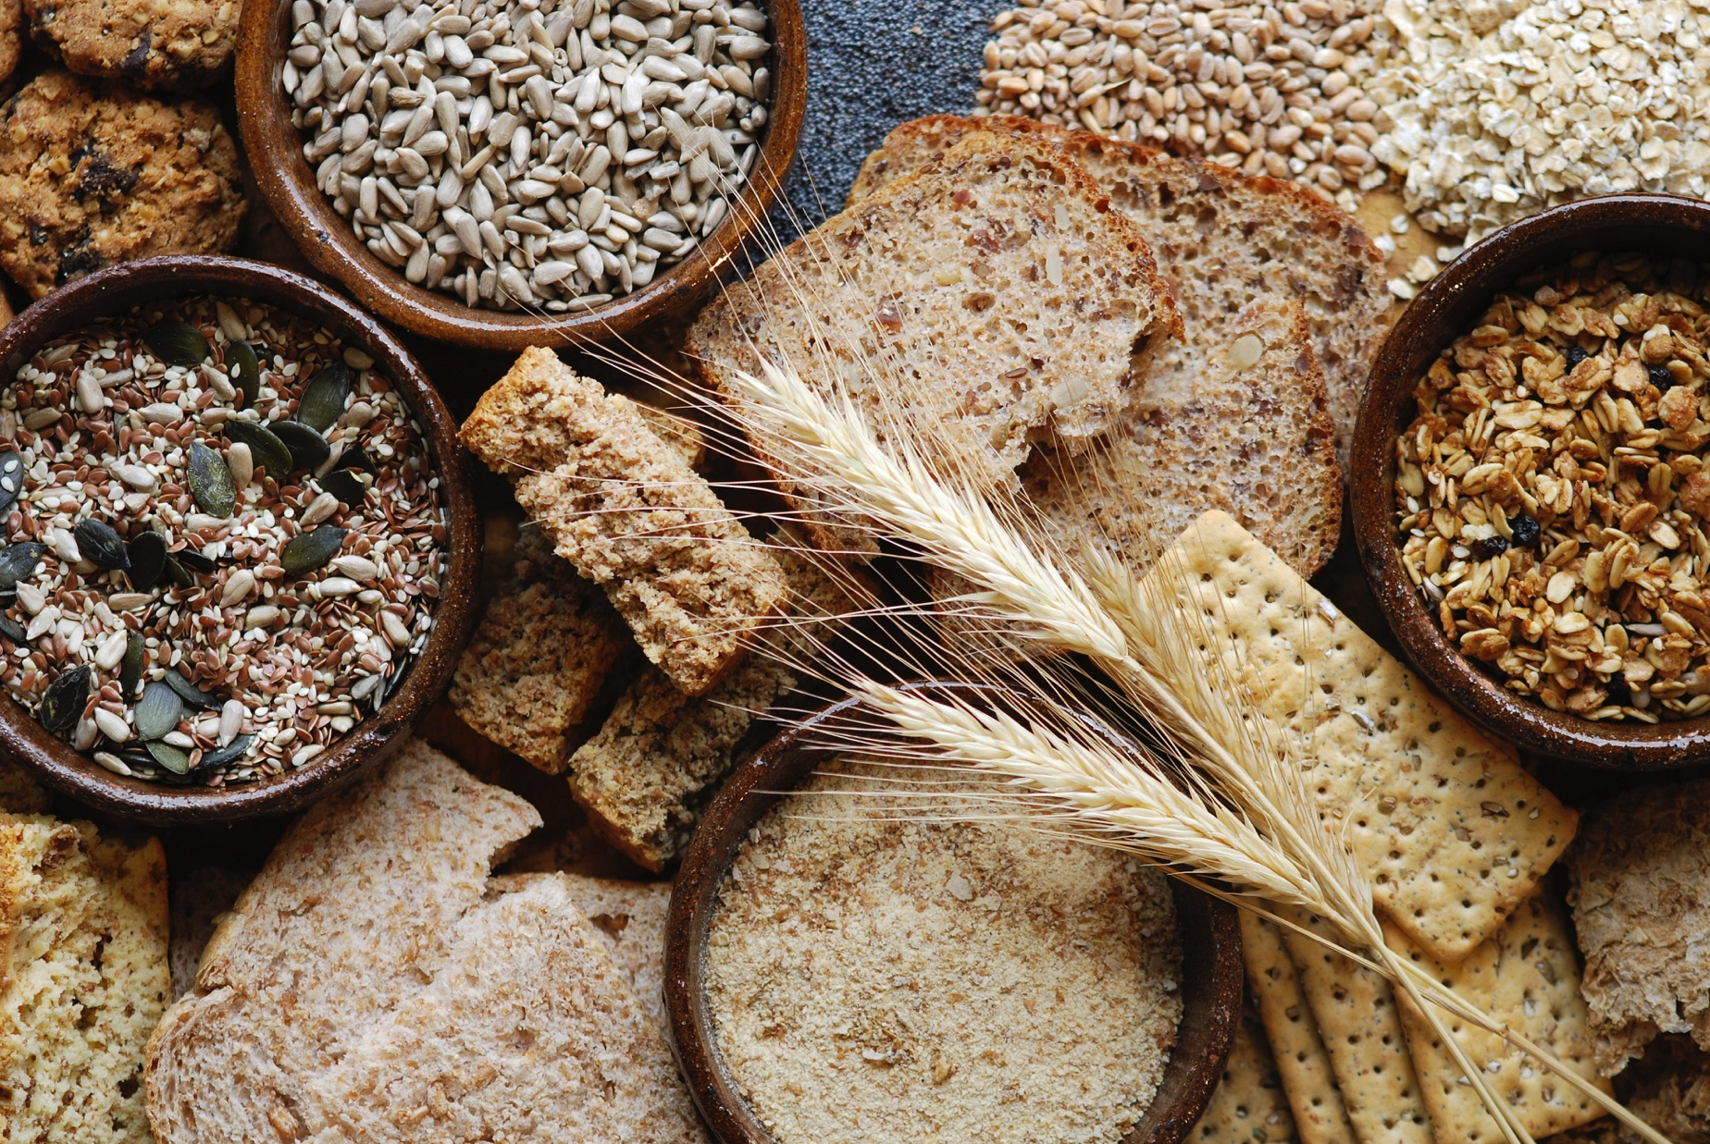

Intermittent high-intensity exercise capacity
Consistently improved with carbohydrate intake
Baker L et al. 2015, Nutrients, 7:5733-5763, doi:10.3390/nu7075249.
Notes:
It is intermittent exercise capacity that is mostly impacted by carbohydrate intake during the protocol
Intermittent high intensity exercise capacity – soccer; soccer/rugby/field hockey; basketball (1);
Ten out of 12 studies found improved intermittent high-intensity exercise capacity with CHO vs. placebo. This finding is perhaps not surprising, given the well-established benefit of carbohydrate intake on endurance exercise capacity.

Slide 7
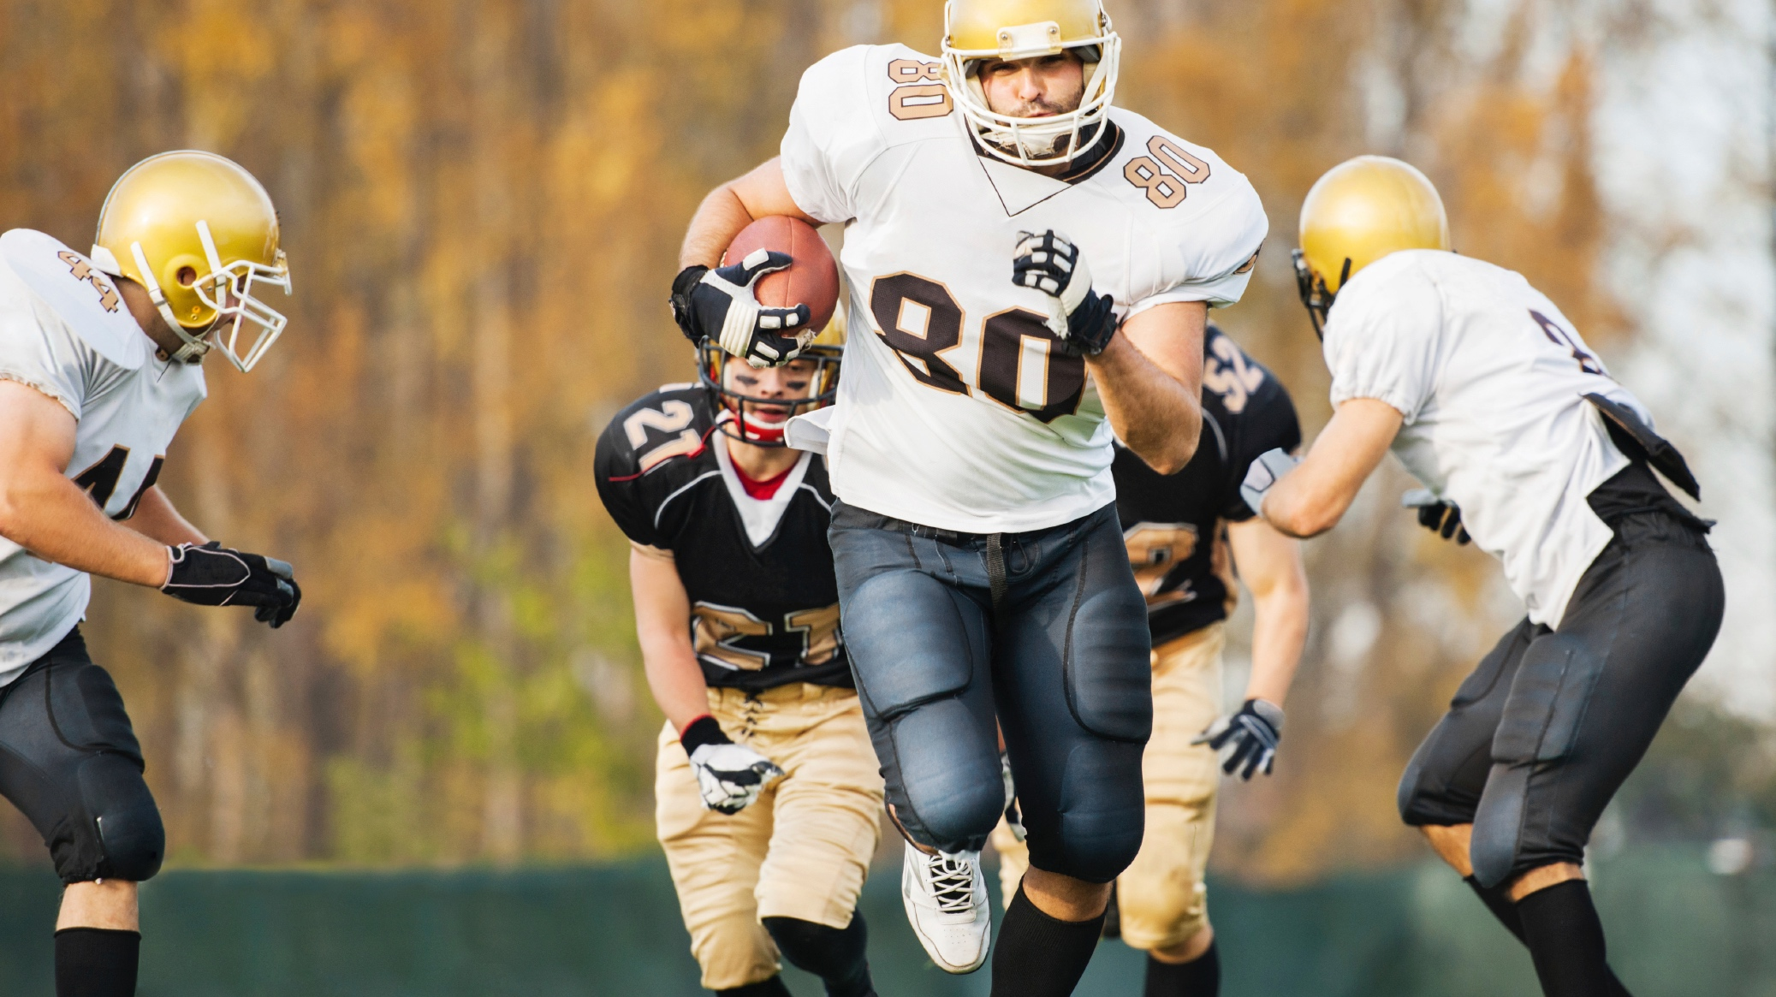

SPRINTING
/
3 out of 4 studies
Baker L et al. 2015, Nutrients, 7:5733-5763, doi:10.3390/nu7075249.
Notes:
Other outcomes measured in team sport studies: Sprinting. 3 of 4 studies found a benefit in the latter parts of the simulated protocol
Sprinting - soccer; soccer/rugby/field hockey; basketball; American football
Most studies but not all suggest no benefit of CHO ingestion on sprint performance in soccer, rugby, field hockey or American football. Three out of 4 basketball studies report a benefit of CHO ingestion on sprint speed in the 4th quarter of a simulated game.

Slide 8

JUMPING
/
1 out of 5 studies
Baker L et al. 2015, Nutrients, 7:5733-5763, doi:10.3390/nu7075249.
Notes:
Jumping – basketball, one soccer
Only 1 study out of 5 reported a benefit of CHO ingestion.

Slide 9
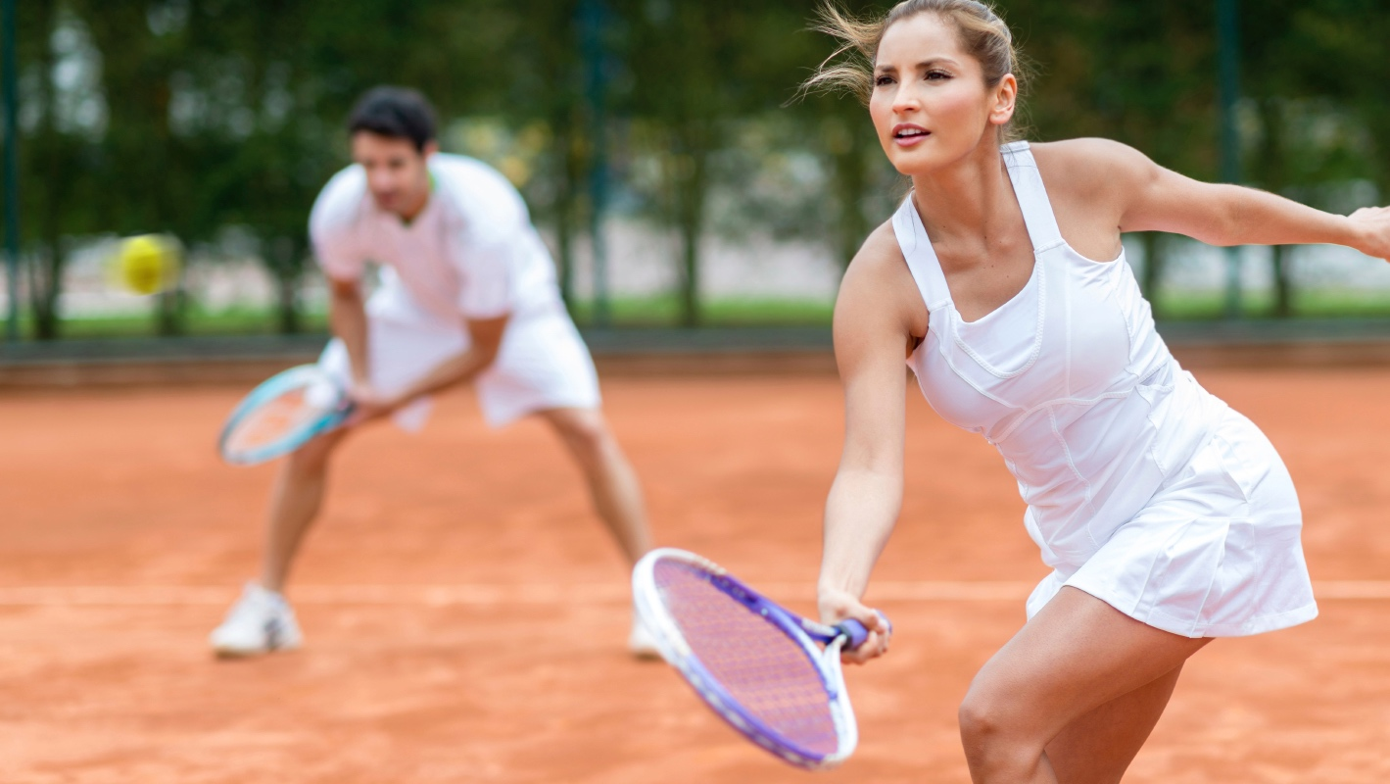

2 out of 4 soccer studies
both basketball studies,
and 1 tennis study
AGILITY
/
Baker L et al. 2015, Nutrients, 7:5733-5763, doi:10.3390/nu7075249.
Notes:
Agility – soccer; basketball; tennis; rugby; non-specific
Two of the 4 soccer studies report a benefit of CHO ingestion on agility. Both basketball studies and the single tennis study report a benefit. The single study in rugby reported no benefit. Non-specific studies report mixed results with 1 reporting a benefit. There is limited data on agility which is difficult to measure. More validation work is needed for sport-specific agility.

Slide 10
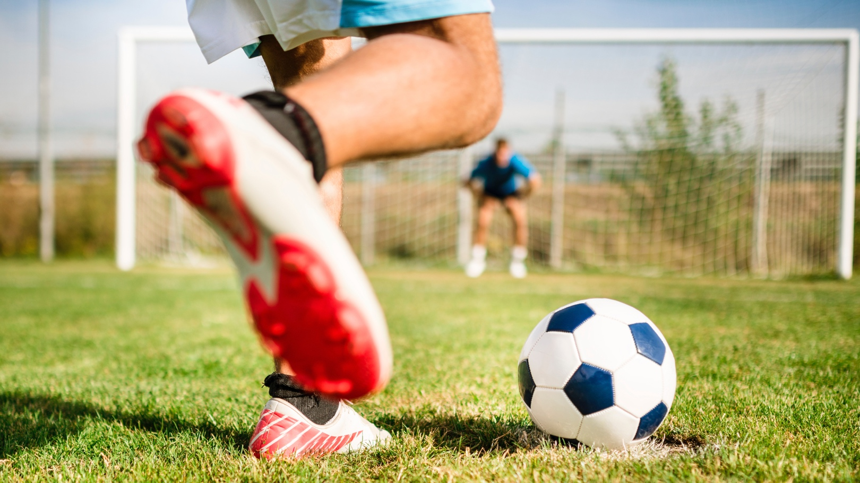
6 out of 8 soccer studies
1 out of 2 basketball studies
3 out of 7 racket sport studies
SKILL
/
Baker L et al. 2015, Nutrients, 7:5733-5763, doi:10.3390/nu7075249.
Notes:
Skill – soccer, basketball, tennis, badminton, squash
Evidence of a beneficial effect of carbohydrate on soccer skills, such as shooting and dribbling. In soccer, 6 of 8 studies have reported improved skill performance with carbohydrate ingestion. Soccer is the sport with the most protocol/skill test validation work. Mixed results found in basketball (1 study reported improved performance, 1 study reported no effect of carbohydrate intake) and racket sports (3 studies reported improved performance, 4 studies reported no effect of carbohydrate intake). Skill is difficult to measure and many different tests have been used. More validation work is needed for measurement of skill in sports.

Slide 11
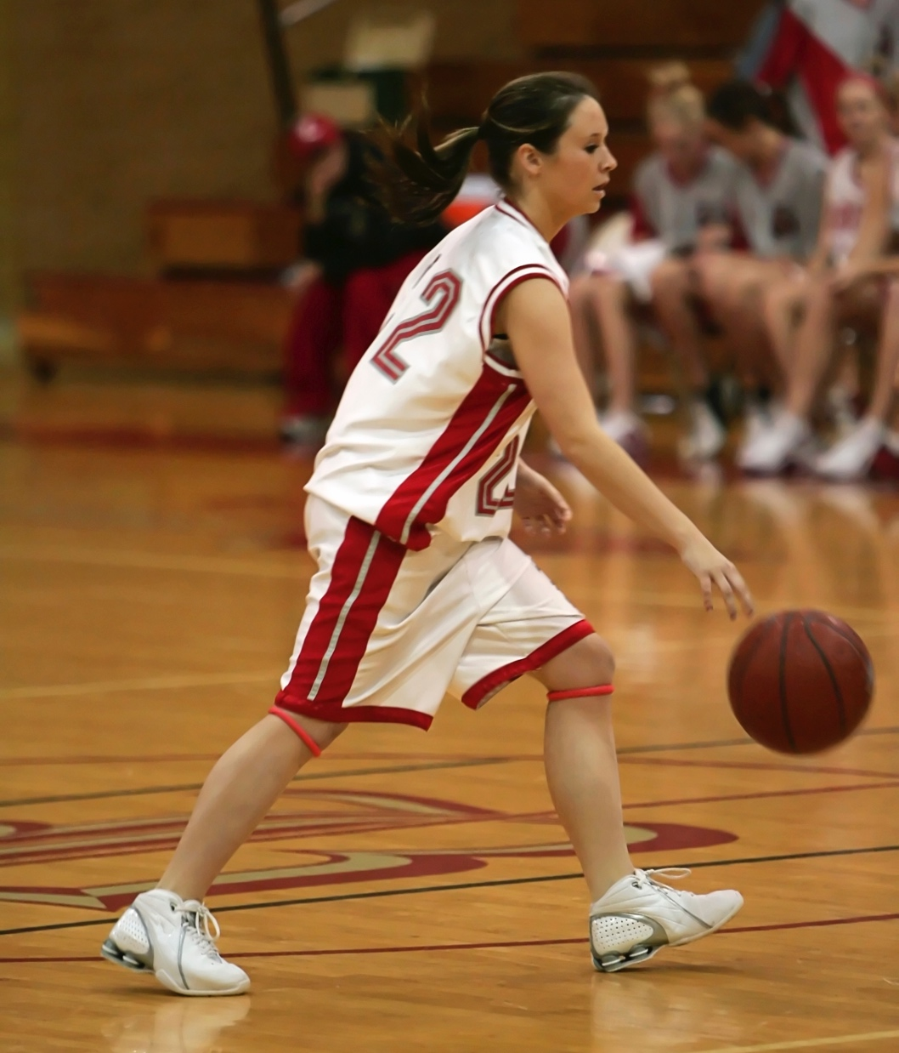

Compared to water, carb intake during a basketball protocol resulted in…
14%
Faster
20 m sprint (4th Q)
37%
Longer
Run time to fatigue
Improved
second-half motor skills
Decreased
second-half fatigue (POMS)
Welsh et al. 2002, MSSE, 34:723-731.
Notes:
Carbohydrate intake has impact when athletes are fatigued
This slide highlights a study using a simulated basketball game model
Athletes were provided ~41 g/h carbohydrate; completed a shuttle run to fatigue, and were found to have faster 20 m sprint, higher jump height, improved motor skills in the 4th quarter
The study design consisted of:
4 15 min quarters
Shuttle run = repeated 20 m intervals at 120% and 55% VO2 max until fatigue
20 m sprint = average sprint time per quarter
Vertical jump = avg of 10 maximal jumps
CHO did not improve vertical jump, cognitive function, or POMS composite score

Slide 12



CARBOHYDRATES AND TEAM SPORTS
Field Sports
STRENGTH + POWER
Field Sports
ENDURANCE
Batting Sports
Court Sports
Short distances covered, many short bursts
Large distances covered, high speeds
Lower overall energy demands, long duration
Smaller area, shorter duration, tournaments, substitutions
CARBOHYDRATES ARE ESSENTIAL
Maintain short energy bursts
To maintain glycogen stores
To maintain
blood glucose
for attention & decision making
To maintain glycogen
over time
Holway & Spriet. 2011, J Sport Sci. 29 Suppl 1:S115-125.
Notes:
There is no research in batting sports, little across other types of sports. But given the intermittent nature of the sport and related physiology we can make some extrapolations… that carbs will be important for all of them, for different reasons

Slide 13
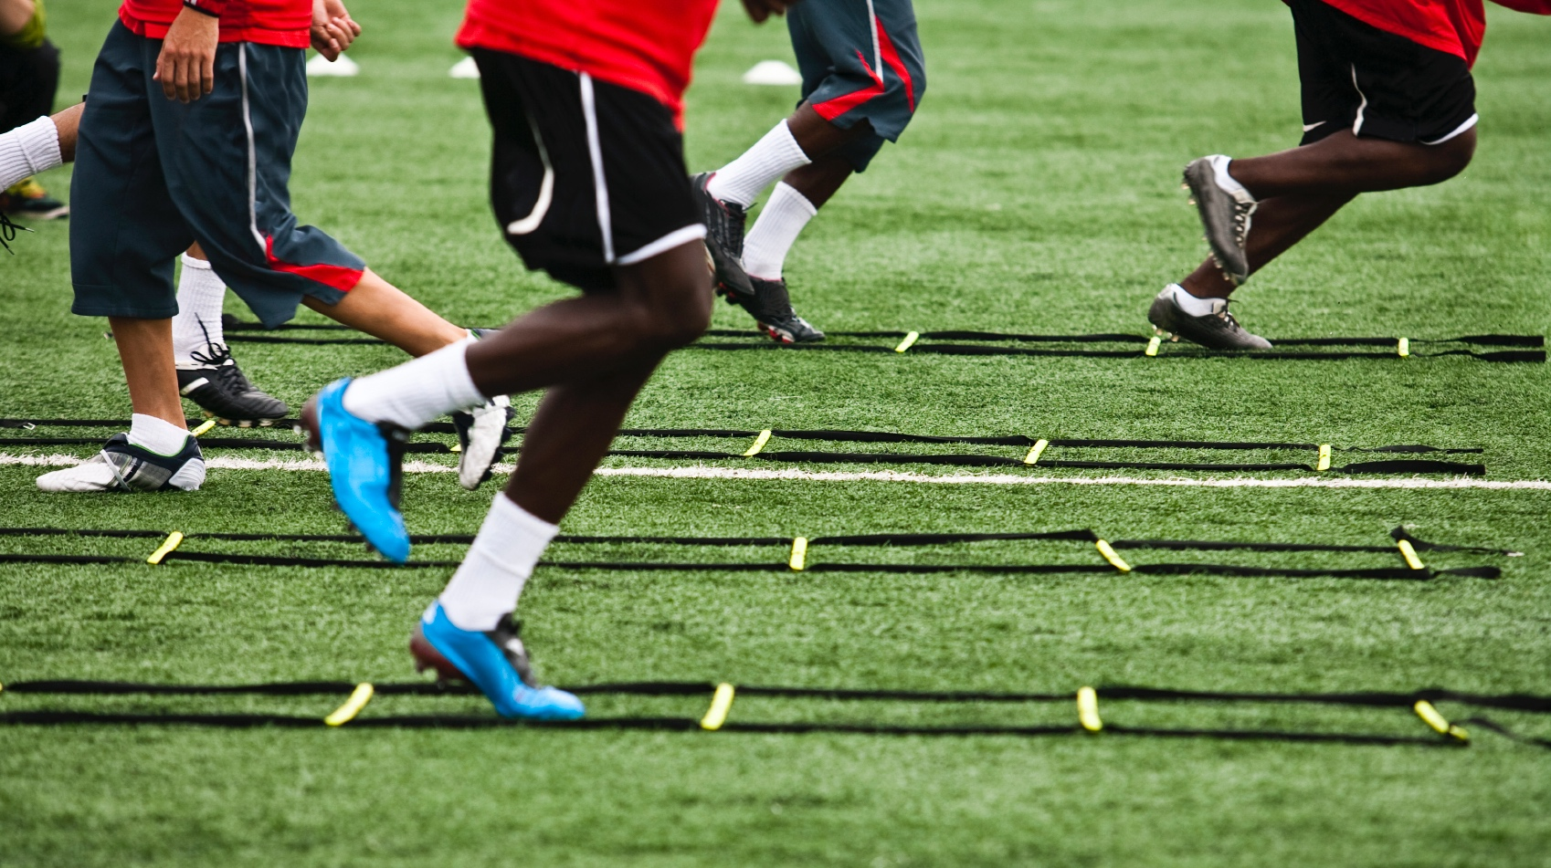


MECHANISM
Glycogen
sparing
Glycogen
re-synthesis
High rate
of CHO Ox
Phillips et al. 2011, Sports Med. 41:559-585.
Baker L et al. 2015, Nutrients, 7:5733-5763, doi:10.3390/nu7075249.
Jeukendrup, Rollo & Carter. Sports Science Exchange (2013) Vol. 26, No. 118, 1-8.
Notes:
Possible mechanisms of exercise capacity enhancement include sparing of glycogen, glycogen resynthesis during low-intensity exercise periods and attenuated effort perception during exercise
Carbohydrate provides a metabolic advantage (high carb oxidation, spare liver glycogen). When we choose types of carbs, want to choose those that result in high rates of ox

Slide 14

A high rate of carbon oxidation
can result in a better performance
Jeukendrup, A. Sports Science Exchange (2013) Vol. 26, No. 108, 1-5.
Jeukendrup, A. 2010, Curr Opin Clin Nutr Metab Care. 13:452-457.
Notes:
When choosing a carbohydrate source during exercise, pick those that result in high exogenous carbohydrate oxidation rates during exercise
What carbs fall into these criteria?

Slide 15
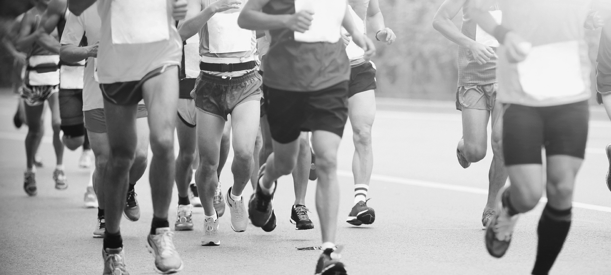



Types of Carbohydrates
Carbohydrate Structure Classifications
FASTER
SLOWER
SIMPLE
COMPLEX
Glucose
Maltose
Sucrose
Maltodextrins
Amylopectin
Fructose
Galactose
Trehalose
Isomalatulose
Amylose
Glucose
Fructose
Galactose
Sucrose
Maltose
Amylose
Amylopectin
Rapid
Digestion
Slow
Digestion
1.0 g/min
(60 g/h)
.06 g/min
(35 g/h)
Notes:
MAKE SURE TO LOOK AT THIS SLIDE WITH THE ANIMATION!
The point is, when choosing carbs during exercise, we need to think about their physiology, how fast they are used by the body - can’t think of the traditional chemical classifications, you can see they are different

Slide 16

During exercise, think about carbs as…
FAST
& SLOW
Notes:
think about carbohydrates as fast and slow – not simple and complex!

Slide 17




CARBOHYDRATE TRANSPORTERS
GLUCOSE
SGLT1
GLUCOSE
INTESTINAL
LUMEN
GLUT5
FRUCTOSE
FRUCTOSE
BLOODSTREAM
Notes:
Some slow carbohydrate is OK, there is a transporter for fructose, but it is slower than glucose
Glucose is absorbed via the SGLT1 transporter (galactose, too, but needs to be converted in the liver). This transporter will saturate at a rate of 1.0 g/min or 60 g/h
The choice of carbohydrate sources are those that are absorbed quickly. That doesn’t mean there isn’t a role for a slow sugar, fructose. It has a separate transporter, the glut 5. I like to use a toll booth analogy. Of course don’t want too much fructose
(Also, this is why carb reccos aren’t based on body weight)

Slide 18

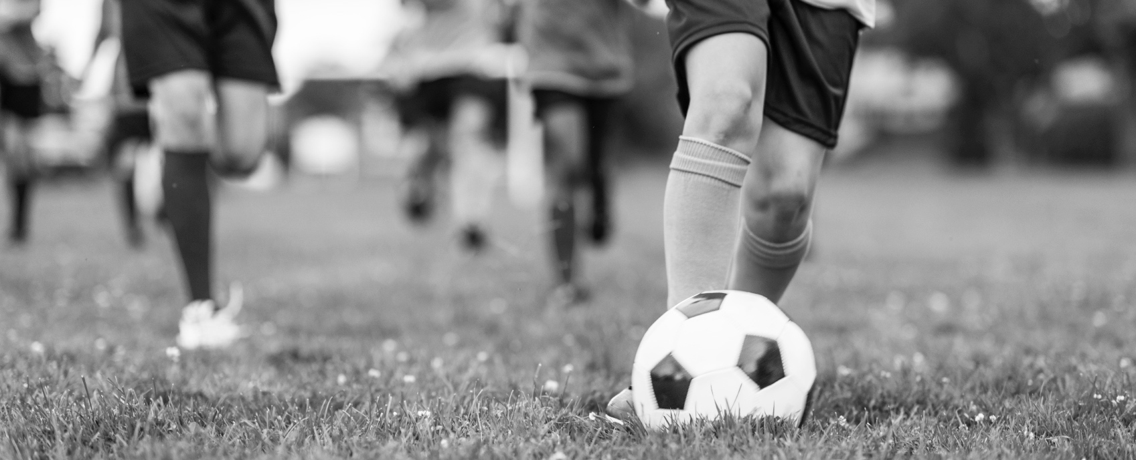
Fructose + glucose combination
FRUCTOSE
+ GLUCOSE
GLUCOSE
Total CHO Oxidation (g/min)
Lecoultre et al. AJCN (2010) 92:1071-1079.
Notes:
Fructose on it’s own is incompletely absorbed and can cause GI distress
Malabsorption of fructose is reduced significantly with glucose, but mechanism not understood
Study out of Luc Tappy’s lab in Switzerland examined fructose + glucose coingestion during prolonged exercise. G+F resulted in 7% increase in total carb oxidation, including increased lactate production and oxidation. (Fructose oxidation explained by increased lactate + glucose ox)
Bottom line – although fructose is not “fast”, it shouldn’t be ignored

Slide 19
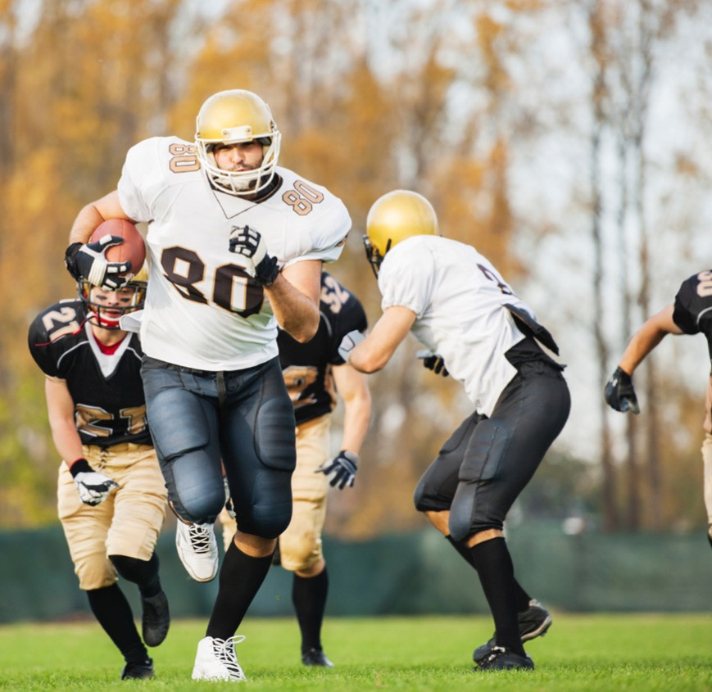
Carbohydrate recommendations for peak performance
3-4 Hours Before
1-4 g/kg
1 Hour Before
~25 g
During
30-60 g/h
≥ 60 min duration
Performance goal
After
1.0-1.2 g/kg
< ~8 h until next training or competition
Joint Position Statement: Nutrition and Athletic Performance. Med Sci Sports Exerc. 48:543-68, 2016.
Notes:
Recommendations for athletes when performance is their goal:
3-4 hours before practice/Competition: 1-4 g/kg(find the amount and timing that is best for your stomach)
In the hour before: try a small amount of easily digested carbohydrates, ~25 g. This can help meeting your “during” needs
During practice/Competition: 30-60 g/h (when going for 60 min or longer)
After practice/Competition: 1.0-1.2 g/kg to refill glycogen stores. This is especially important if the athlete has a short time to recover (<8 hours)

Slide 20

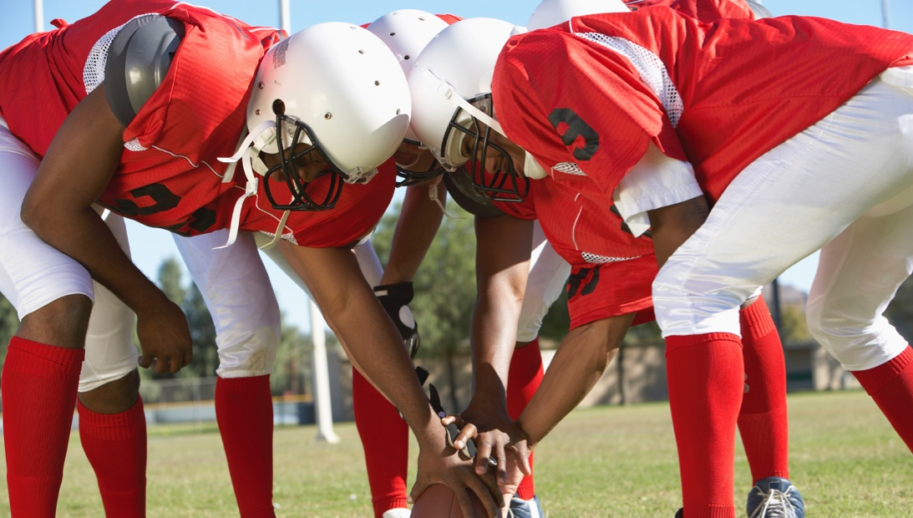
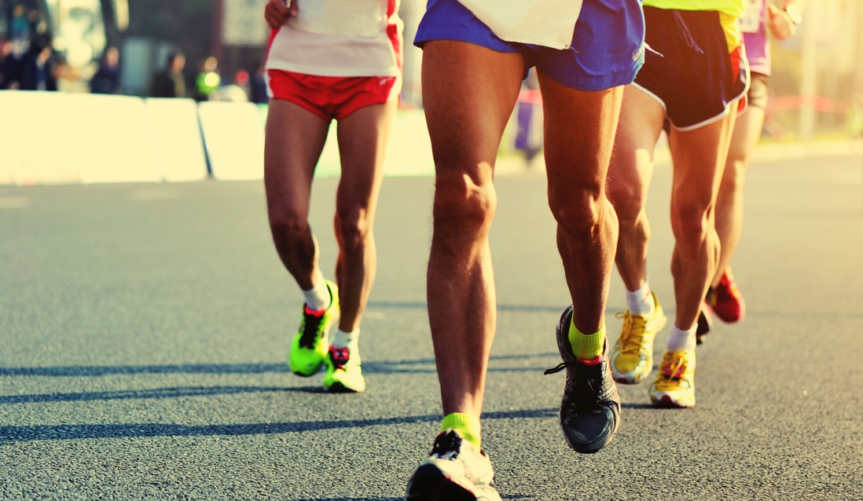

CARBOHYDRATE RECOMMENDATIONS
CONSIDER
Amount
Type
Duration
TEAM
SPORTS
ENDURANCE
SPORTS
30-60 g/h
Up to 90 g/h
(≥ 1h)
(≥ 2.5h)
Joint Positon Statement: Nutrition and Athletic Performance. Med Sci Sports Exerc. 48:543-68, 2016.
Notes:
Use this slide to talk more about DURING
Of the amount consumed, about 70-90% will be oxidized, which is of course important for a performance benefit. The remaining will be oxidized during recover or used to replenish glycogen. This is referred to as oxidation efficiency. The actual amount depends on the amount, type and duration.
Of course don’t want to recommend an athlete gets to this range all at once if they aren’t currently consuming or consuming very little – start slow and get them to the right amount over time to avoid GI distress
It is possible and often necessary to “train the gut”

Slide 21
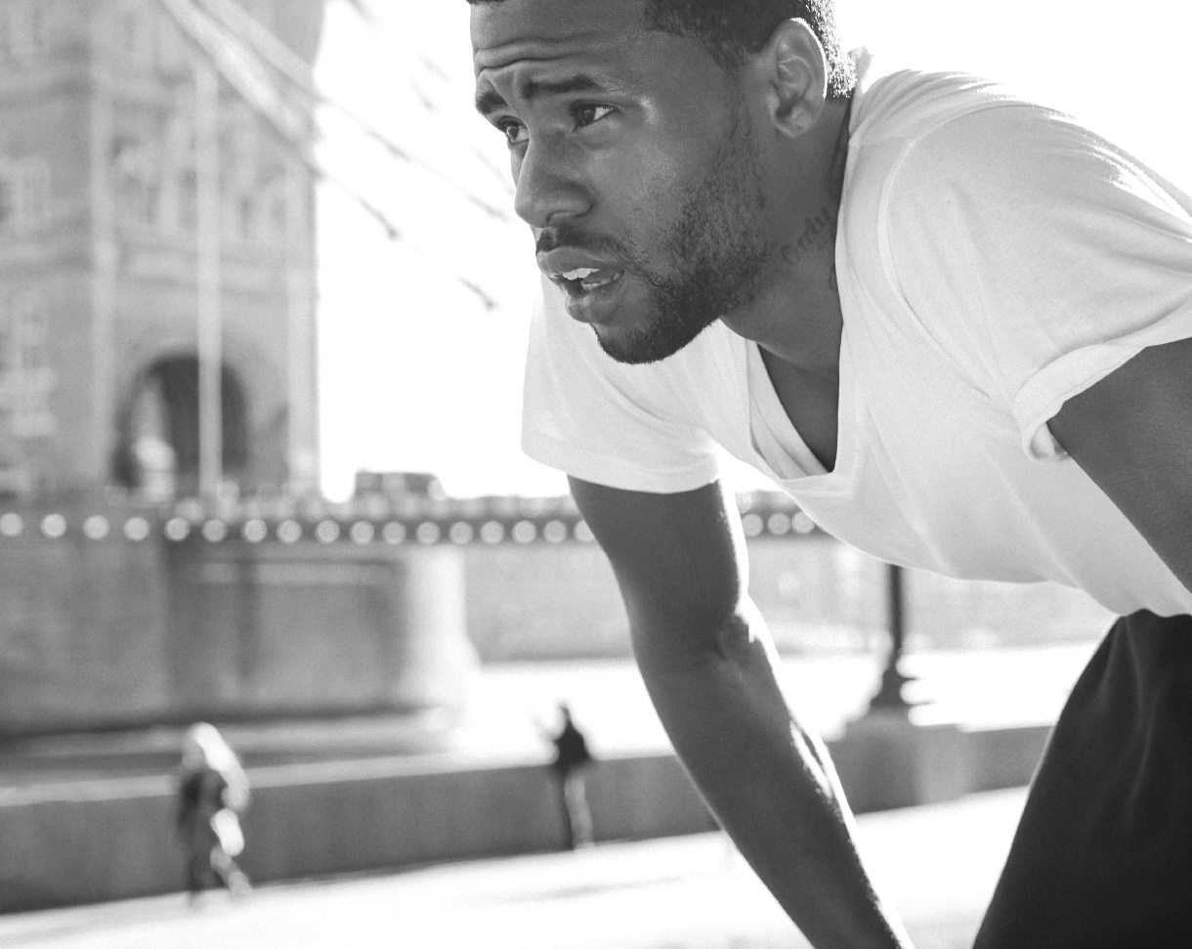
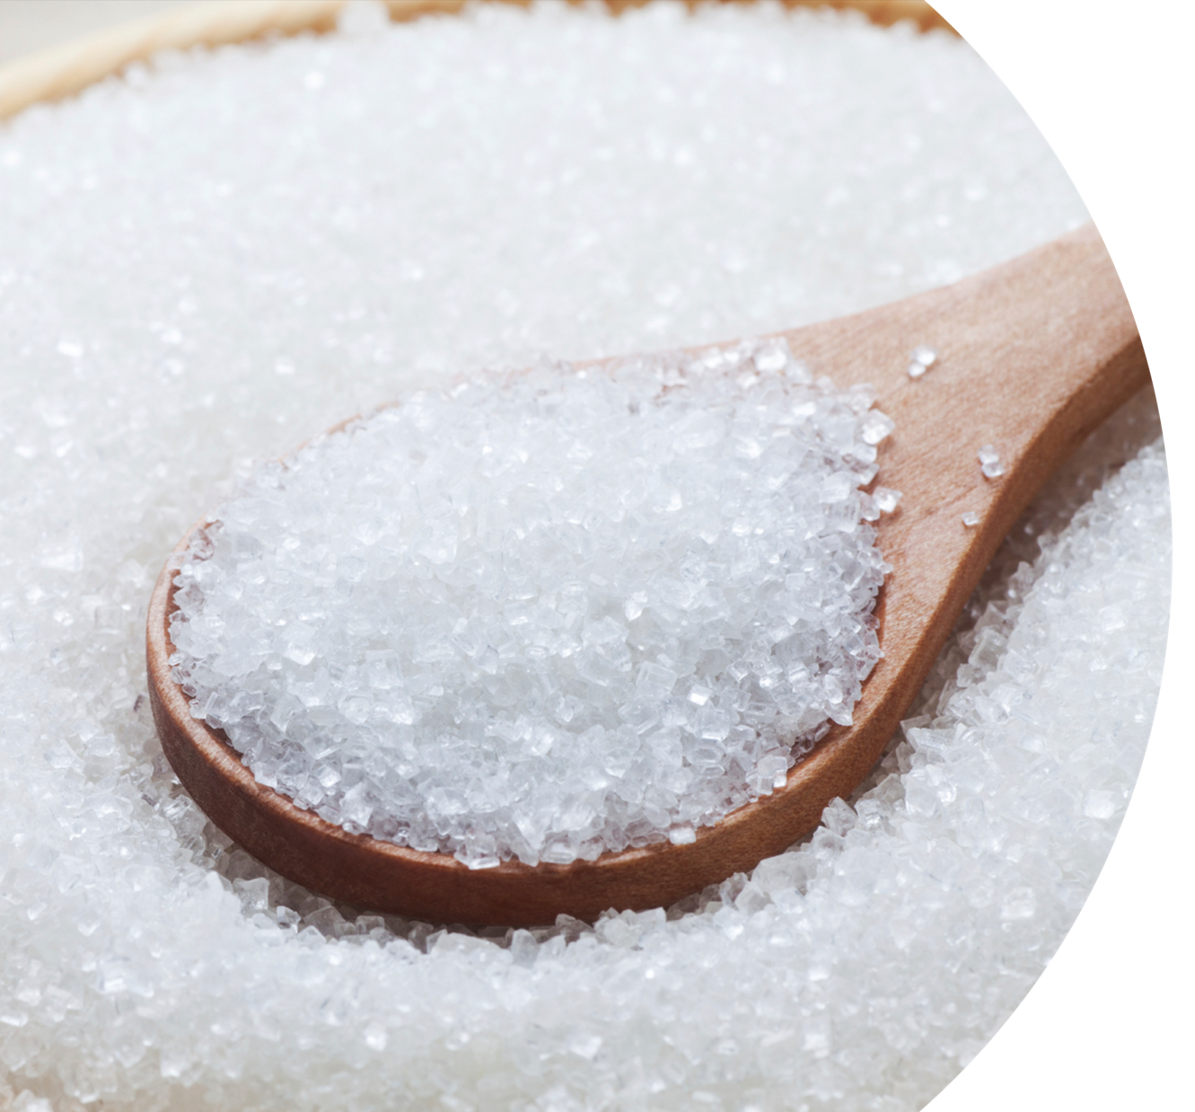
ZERO
CALORIES
ZERO
ENERGY
Notes:
Zero calorie sweeteners include sucralose, aspartame, acesulfame K, stevia, and sugar alcohols. Sugar alcohols, for example xylitol, erithrytol, mannitol, are not exactly zero calorie. They are incompletely absorbed into the bloodstream and result in blunted blood glucose response.
All of these compounds provide sweetness similar to sugar. This is important since if an athlete likes what they are eating, especially during exercise, they are more likely to eat the right amounts.
However, unlike sugar, these sweeteners do not have calories and therefore do not provide energy to the athlete. For an athlete who needs energy from carbohydrate, it is important they do not mistake the presence of a sweetener for a sugar.

Slide 22

Carbohydrate Summary
Primary fuel; improves endurance and predictors of team sport performance
Chose quickly oxidized carbs, including the sugars glucose & sucrose, during training & competition
Consume before, during and after when the goal is PERFORMANCE

